Slide 1

ResAI Toolkit: Framework for Cross-Modality Bias Detection
24-25J-195

Slide 2
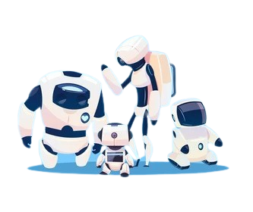
Team
K.M.S.P. Jayawardena.
H.M.I.K Dhanawardena.
E.M.A.M Ekanayake .
T. N. Mudalige.

Slide 3
How has AI transformed our world?
Increased efficiency.
Enhanced Personalization.
Informed decision making.
Improved accessibility.
Innovation and creativity.

Slide 4




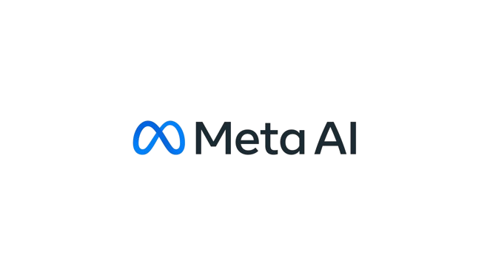
The Dark Side of AI: Biasness.
What is Bias?
Situation where a model performs inconsistently across different demographic groups.
Consequences:
Amplifies societal disparities.
Amazon’s recruitment system.
Gender biasness in known LLM models.
Failure of face recognition systems.
Unfair arrests.
Predpol: crime detection system.

Slide 5


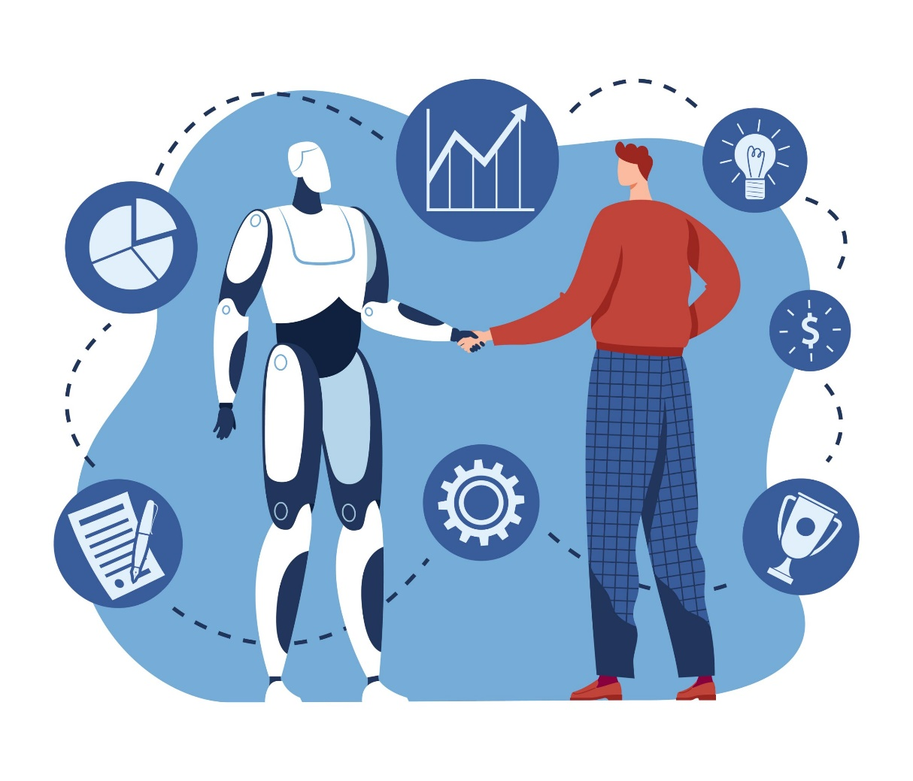
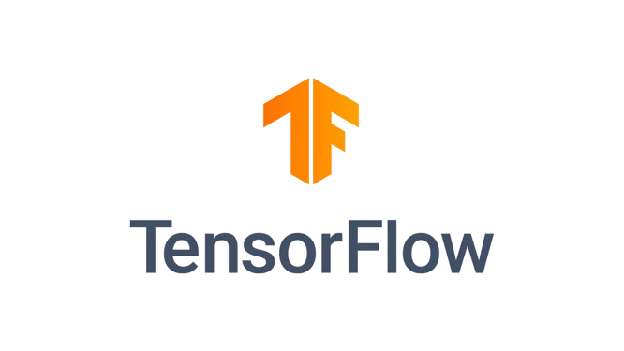
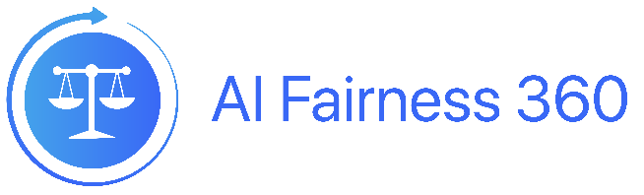
Can Bias Be Detected?
Bias-Detecting Metrics:
Tools designed to identify and quantify biases in Artificial Intelligent models.
Existing Tools used for Bias Detection:
AI Fairness 360
Fairlearn
Google’s What-If Tool
TensorFlow Fairness Indicators

Slide 6
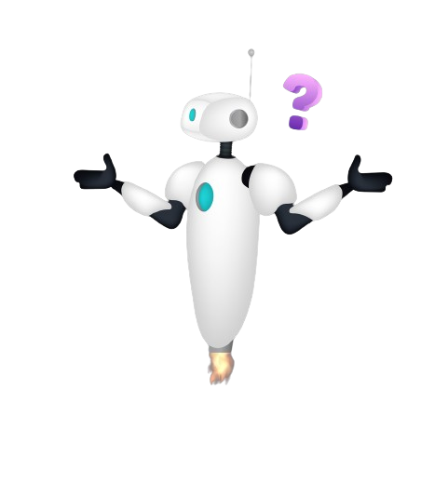
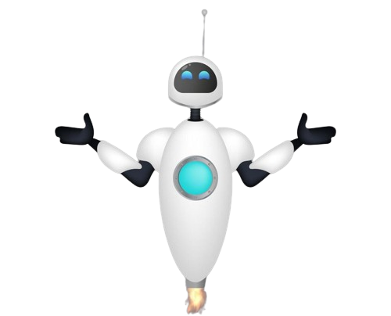
Challenges of Existing Solutions
What are the limitations of current AI bias detection methods?
Lack of universal applicability across data types.
Introducing additional bias in data processing.
Loss of information while converting data.
What if we had a common solution to detect bias across data types?

Slide 7

Introducing the ResAI Toolkit.
Main Objective:
Develop a Comprehensive Framework for detecting bias across multiple data modalities in AI systems.
Sub Objectives:
Create Specific Metrics
Enhance Fairness and Reliability
Ethical AI Development

Slide 8
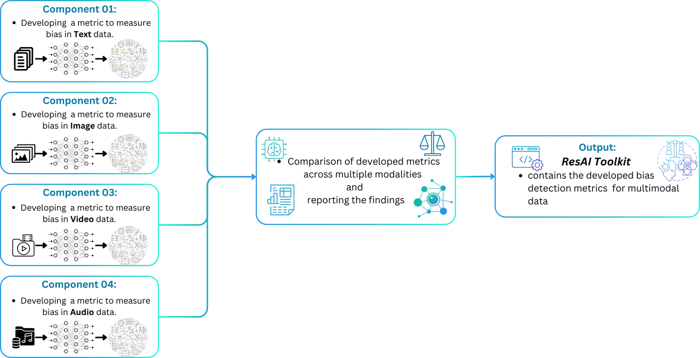
How does the ResAI Toolkit revolutionize AI bias detection?

Slide 9
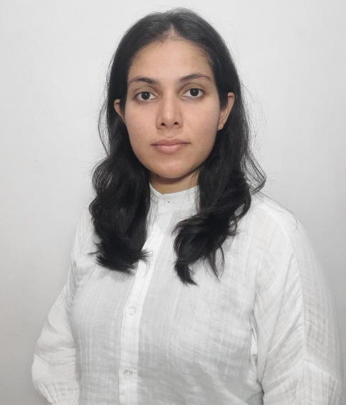
IT21380914 | K. M. S. P. JAYAWARDENA
Data Science
IT21380914 | K. M. S. P. Jayawardena | 24_25J_195

Slide 10
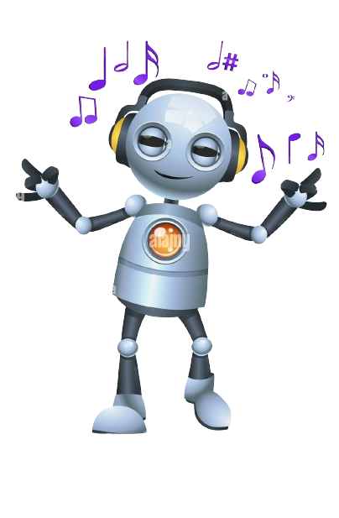
Developing a metrics for detecting bias in audio datasets.
Background.
Existing metrics and related works.
Limitations on existing metrics
Objectives.
methodology.
System diagram.
Technologies to be used
Requirement specification.
Gantt chart.
IT21380914 | K. M. S. P. Jayawardena | 24_25J_195

Slide 11
Background.
What are the crucial AI systems that use Audio data?
How does audio bias affect these systems?
How can we measure this biasness?
IT21380914 | K. M. S. P. Jayawardena | 24_25J_195

Slide 12
Existing metrics and Related works.
Character Error rate(CER):
J. Meyer, L. Rauchenstein, J. D. Eisenberg, N. Howell, 2020 , “Artie Bias Corpus: An Open Dataset for Detecting Demographic Bias in Speech Applications”.
Word Error rate(WER):
S. Feng, O. Kudina, B. M. Halpern and O. Scharenborg, 2021 , “Quantifying Bias in Automatic Speech Recognition”.
M. Z. Boito, L. Besacier, N. Tomashenko, Y. Est`eve, 2022 , “A Study of Gender Impact in Self-supervised Models for Speech-to-Text Systems” .
Tanvina Patel and Odette Scharenborg, 2023 , “Using Data Augmentations and VTLN to Reduce Bias in Dutch End-to-EndSpeech Recognition Systems” .
IT21380914 | K. M. S. P. Jayawardena | 24_25J_195

Slide 13
Existing metrics and Related works.
Class Imbalance
C. Sekkat, F. Leroy, S. Mdhaffar & et al., 2024 , “Sonos Voice Control Bias Assessment Dataset: A Methodology for Demographic Bias Assessment in Voice Assistants ”.
Statistical Analysis(univariate and multivariate analysis)
Andrew Bailey, Mark D. Plumbley, 2021 , “Gender Bias in Depression Detection Using Audio Features”
IT21380914 | K. M. S. P. Jayawardena | 24_25J_195

Slide 14
Limitations of existing metrics.
Character Error rate , Word Error Rate and Class Imbalance.
Does not take Multiple demographics into consideration.
Univariate and multi-variate statistical analysis.
Considers the multiple demographics .
Assume demography independence.
IT21380914 | K. M. S. P. Jayawardena | 24_25J_195

Slide 15
Objectives.
Specific Objective.
Sub Objective.
The main goal of the component is to develop a robust metric to measure bias with consideration
Understanding the effect of different biases introduced by audio data.
Understanding how different demographics affect bias.
Understanding the Impact of additional audio features like intonations and speech patterns on bias detection.
IT21380914 | K. M. S. P. Jayawardena | 24_25J_195

Slide 16
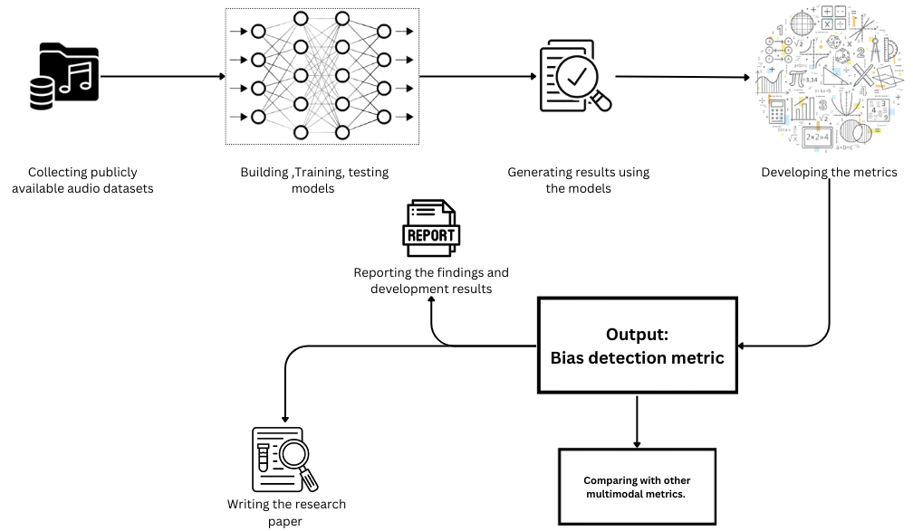
System diagram.
IT21380914 | K. M. S. P. Jayawardena | 24_25J_195

Slide 17
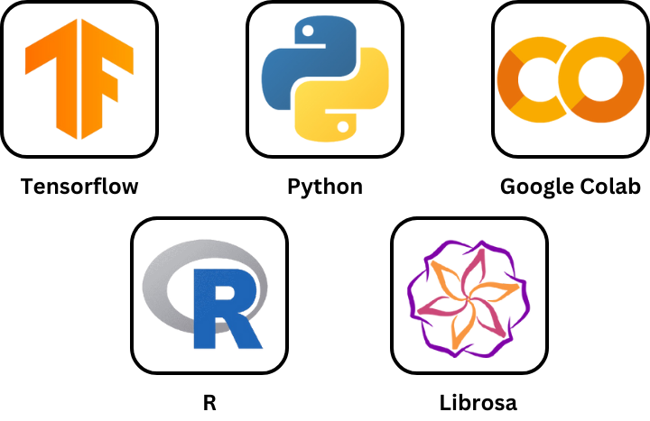
Technologies to be used.
IT21380914 | K. M. S. P. Jayawardena | 24_25J_195

Slide 18
Requirements specification.
Functional requirements
Detect and measure bias across different demographics.
Non-functional requirements
Reliable.
Interoperability.
Scalable.
Ethical.
Detect and measure bias across different audio features.
IT21380914 | K. M. S. P. Jayawardena | 24_25J_195

Slide 19
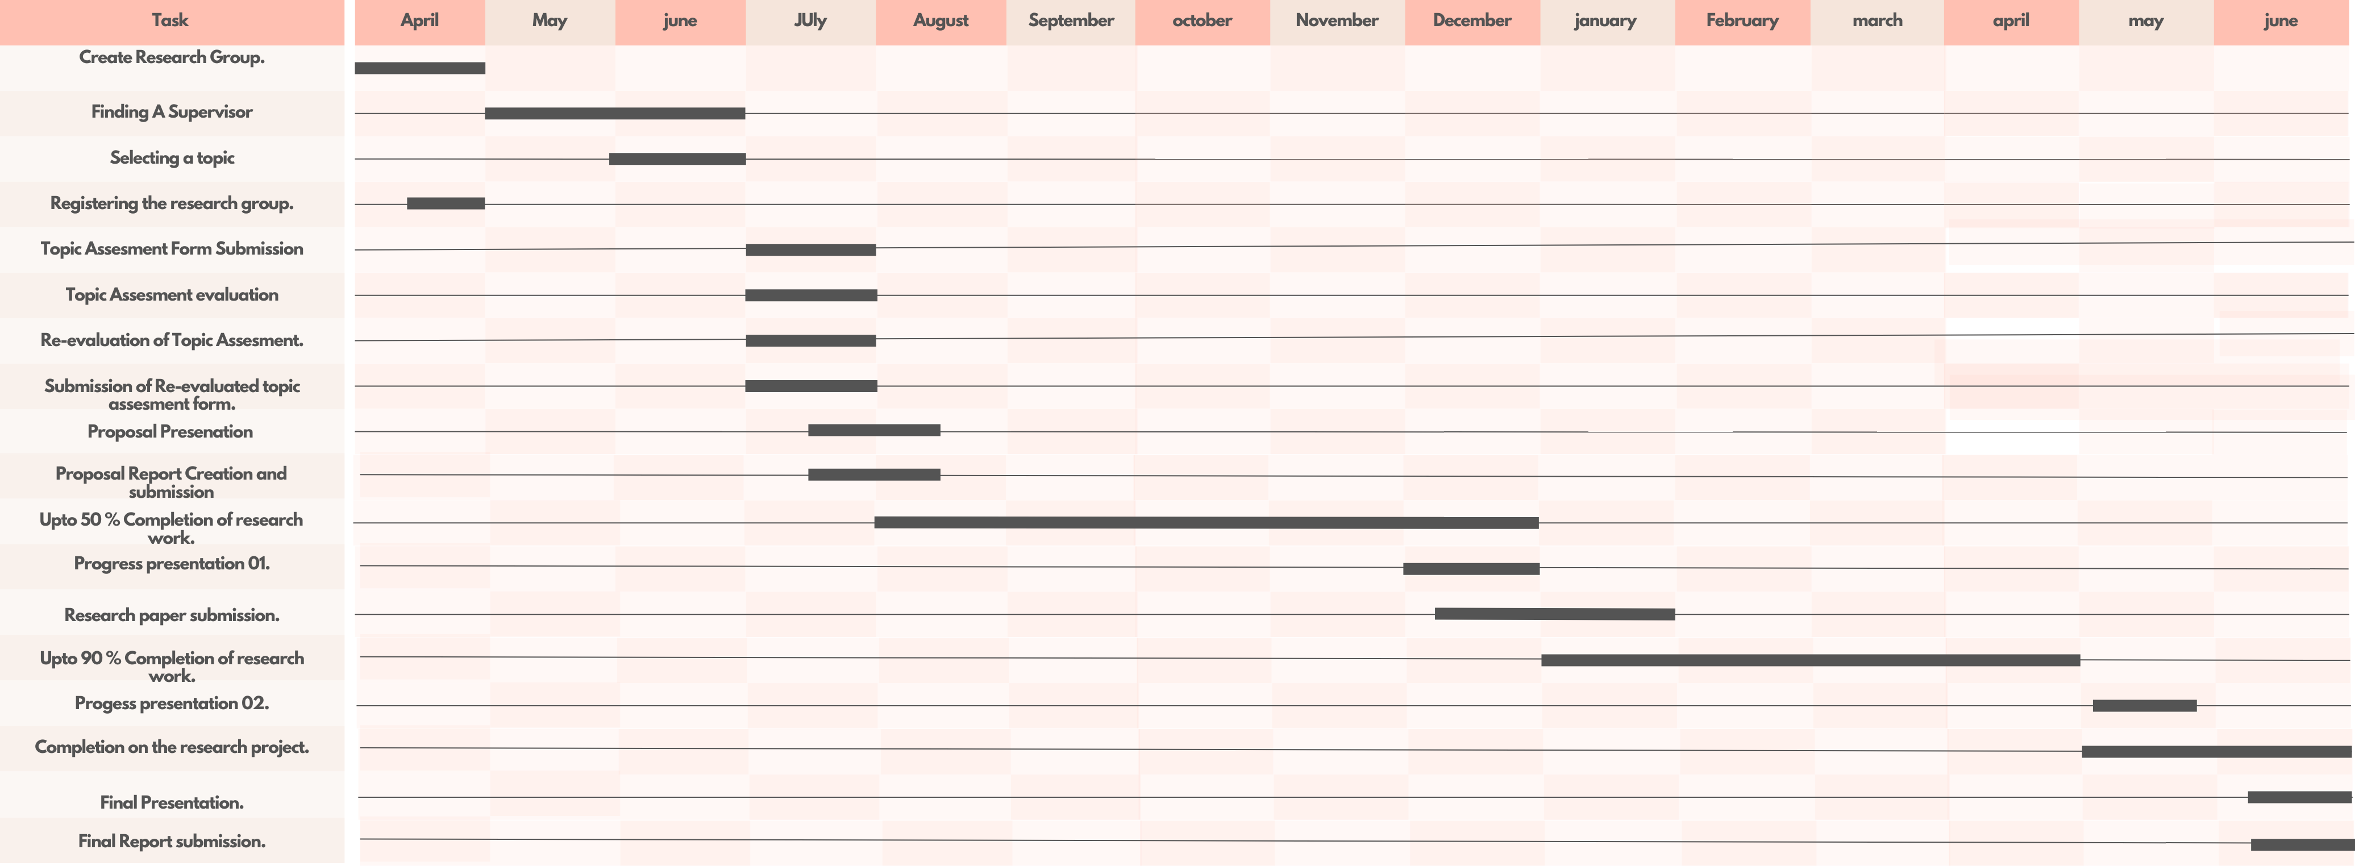
Gannt Chart
IT21380914 | K. M. S. P. Jayawardena | 24_25J_195

Slide 20
References.
J. Meyer, L. Rauchenstein, J. D. Eisenberg, N. Howell, 2020 , “Artie Bias Corpus: An Open Dataset for Detecting Demographic Bias in Speech Applications”.
S. Feng, O. Kudina, B. M. Halpern and O. Scharenborg, 2021 , “Quantifying Bias in Automatic Speech Recognition”.
Andrew Bailey, Mark D. Plumbley, 2021 , “Gender Bias in Depression Detection Using Audio Features”.
M. Z. Boito, L. Besacier, N. Tomashenko, Y. Est`eve, 2022 , “A Study of Gender Impact in Self-supervised Models for Speech-to-Text Systems” .
Tanvina Patel and Odette Scharenborg, 2023 , “Using Data Augmentations and VTLN to Reduce Bias in Dutch End-to-EndSpeech Recognition Systems” .
C. Sekkat, F. Leroy, S. Mdhaffar & et al., 2024 , “Sonos Voice Control Bias Assessment Dataset: A Methodology for Demographic Bias Assessment in Voice Assistants ”.
S. A. M. J. F. A. Peña,2020, "Bias in Multimodal AI: Testbed for Fair Automatic Recruitment," .
Brandon M. Booth, Sang EunWoo and et al.,2021,“Bias and Fairness in Multimodal Machine Learning: A Case Study of Automated Video Interviews”.
IT21380914 | K. M. S. P. Jayawardena | 24_25J_195

Slide 21
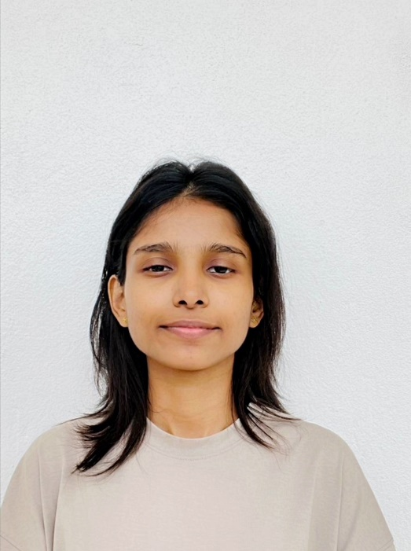
IT21208294 | Mudalige T.N.
Data Science
IT21208294 | Mudalige T.N. | 24_25J_195

Slide 22
Component 02: Developing a metrics for detecting bias in VIDEO datasets.
Background.
Research gap.
Objectives.
Proposed methodology.
System diagram.
Technologies to be used
Requirement specification.
IT21208294 | Mudalige T.N. | 24_25J_195

Slide 23
Background.
What are the AI systems that use Videos?
How does Video bias affect these systems?
How will our metric help?
IT21208294 | Mudalige T.N. | 24_25J_195

Slide 24
Existing metrics and Related works.
mAP:
VmAP:
Chetan Arora, Anupam Sobti, Vaibhav Mavi, M Balakrishnan, 2021 , “VmAP: A Fair Metric for Video Object Detection”.
W. Dally, Huizi Mao, Xiaodong Yang, 2019, “A Delay Metric for Video Object Detection: What Average Precision Fails to Tell”.
IT21208294 | Mudalige T.N. | 24_25J_195

Slide 25
Limitations of existing metrics.
mAP
mAP does not account for the potential of tracking to recover missed detections in the temporal neighborhood
VmAP
Results are vary based on how frames are grouped.
Lack of Demographic bias analysis.
IT21208294 | Mudalige T.N. | 24_25J_195

Slide 26
Objectives.
Specific Objective.
Sub Objective.
Develop novel metrics to measure biases in video data, overcoming the limitations of existing statistical methods and ensuring accuracy in decision-making.
Understanding the Effect of Different Biases Introduced by Video Data
Understanding How Different Demographics Are Represented in Video Datasets
Understanding the Impact of Additional Video Features on Bias Detection
IT21208294 | Mudalige T.N. | 24_25J_195

Slide 27
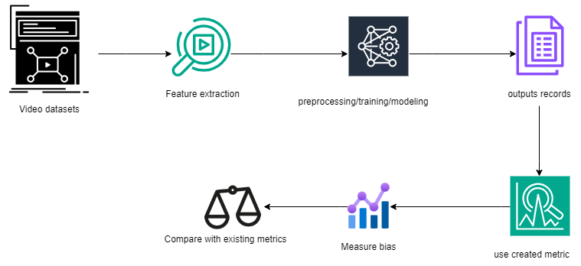
System diagram.
IT21208294 | Mudalige T.N. | 24_25J_195

Slide 28
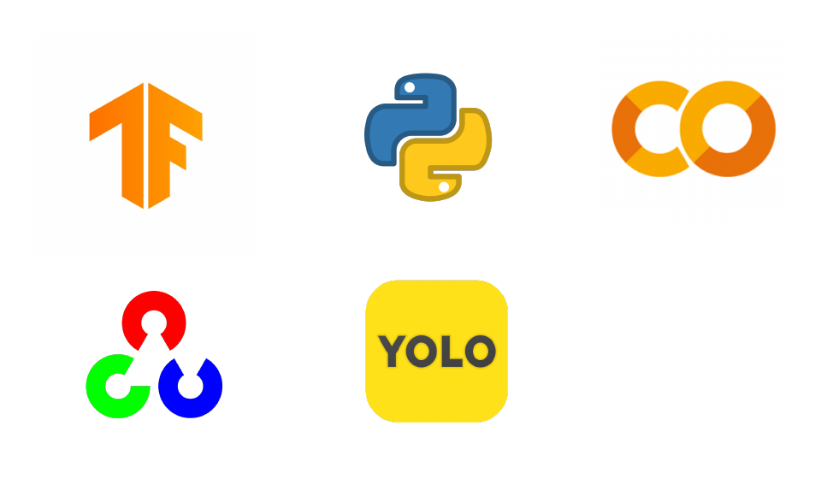
Technologies to be used.
IT21208294 | Mudalige T.N. | 24_25J_195

Slide 29
Requirements specification.
Functional requirements
Non-functional requirements
Reliable.
Scalable.
Ethical.
The metric should be able to detect bias that evolves over time within a video.
The metric should be able to evaluate bias across different demographic groups
IT21208294 | Mudalige T.N. | 24_25J_195

Slide 30
References.
W. Dally, Huizi Mao, Xiaodong Yang, “A Delay Metric for Video Object Detection: What Average Precision Fails to Tell” ,2019, [Online].
S. Yan, D. Huang, M. Soleymani, “Mitigating biases in multimodal personality assessment”. ICMI’20 Virtual even Netherlands, October 2020. [Online].
L. H. S. K. S. L. T. B. Booth, "Bias and Fairness in Multimodal Machine Learning: A Case Study of Automated Video Interviews," ResearchGate, Oct. 2021. [Online].
Chetan Arora, Anupam Sobti, Vaibhav Mavi, M Balakrishnan,“VmAP: A Fair Metric for Video Object Detection”, 2021, [Online].
IT21208294 | Mudalige T.N. | 24_25J_195

Slide 31

IT21183690 | Dhanawardhana H.M.I.K
DATA SCIENCE
IT21387562 | EKANAYAKE E.M.A.M | <<Project ID>>

Slide 32
COMPONENT 03: DEVELOPING A MTETRIC FOR DETECTING BIAS IN TEXT DATASETS.
Background.
Research Problem.
Existing Metrics and Related works
Objectives.
Proposed methodology.
System diagram.
Technologies to be used
Requirement specification.

Slide 33

BACKGROUND
WHAT IS TEXT-BASED DATA BIAS ?
HOW DOES TEXT-BASED DATA BIAS OCCUR?
HOW WILL THE NEW METRIC HELP?

Slide 34
WHAT IS TEXT-BASED DATA BIAS ?
The term "text data bias" describes the systematic and unfair representation or omission of certain groups, perspectives, or characteristics in text-based datasets.

Slide 35
RESEARCH PROBLEM
Research will focus on developing new metrics that incorporate contextual meanings and effectively measure word embedding biases in text-based data. Additionally, it will involve validating these metrics and integrating them into existing fairness toolkits to ensure practical usability and impact.

Slide 36
Existing Metrics and Related works
Addressing the limitations of Existing metrics for bias detection in word embedding.
T. Li, J. Wang, and L. K. Lin, 2023 “Measuring Biases of Word Embeddings: What Similarity Measures and Descriptive Statistics to Use,”
E. Y. Zhao, D. B. Ruiz, and D. J. Jackson,2021 “Evaluating Metrics for Bias in Word Embeddings”
Valentini, G. Rosati, D. Blasi, D. Fernandez Slezak, and E. Altszyler, 2021“On the Interpretability and Significance of Bias Metrics in Texts: a PMI-based Approach”

Slide 37
OBJECTIVES
Specific Objective
To develop and validate new metrics that effectively measure bias in text data considering word embeddings.
Understanding the Effect of Different Biases Introduced by Text Data.
Design and develop new metrics to detect biases in text data
Design validation frameworks to evaluate the accuracy and reliability of the new metrics
Sub Objectives

Slide 38
METHODOLOGY
SYSTEM DIAGRAM
TECHNOLOGIES TO BE USED
REQUIREMENT SPESIFICATION

Slide 39
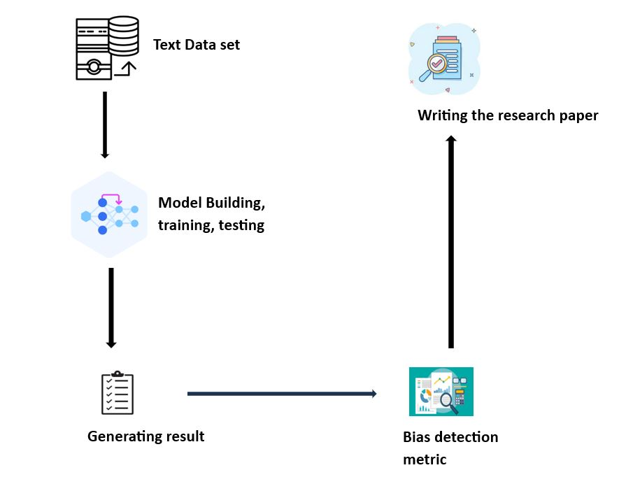
SYSTEM DIAGRAM

Slide 40
TECHNOLOGIES TO BE USED

Slide 41
REQUIREMENT SPECIFICATION
Functional Requirements
Bias Detection Metric Development
Extend the metric to detect Word embedding biases
Evaluation and Validation
Implementation and Integration
Non-Functional Requirements
Scalability
Reliability
Usability
Ethical

Slide 42
REFERENCES
S. Schröder, A. Schulz, P. Kenneweg, R. Feldhans, F. Hinder, and B. Hammer, "Evaluating Metrics for Bias in Word Embedding," 2021.
H. Azarpanah and M. Farhadloo, "Measuring Biases of Word Embeddings: What Similarity Measures and Descriptive Statistics to Use?" 2023.
F. Valentini, G. Rosati, D. Blasi, D. Fernandez Slezak, and E. Altszyler, "On the Interpretability and Significance of Bias Metrics in Texts: A PMI-based Approach," 2021.
F. Valentini, G. Rosati, D. Fernandez Slezak, and E. Altszyler, "The Undesirable Dependence on Frequency of Gender Bias Metrics Based on Word Embeddings," submitted on 2 Jan 2023.

Slide 43
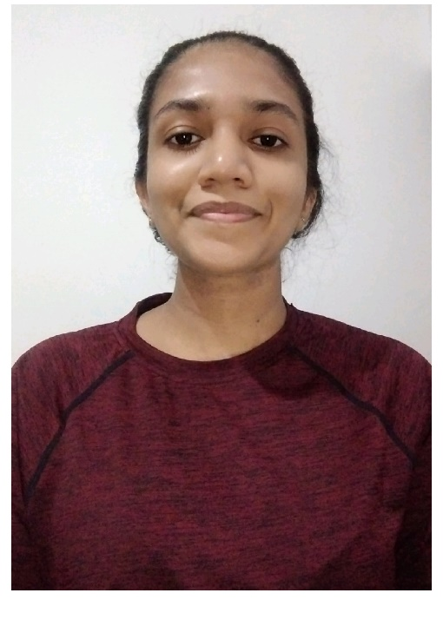
IT21387562 | E.M.A.M EKANAYAKE
Data Science
IT21387562 | E.M.A.M.EKANAYAKE | 24_25J_195

Slide 44
Component 04: Developing a metrics for Measuring CONTEXTUAL bias in IMAGE datasets.
Background.
Research gap.
Objectives.
Proposed methodology.
System diagram.
Technologies to be used
Requirement specification.
IT21387562 | E.M.A.M.EKANAYAKE | 24_25J_195

Slide 45

Background
WHAT IS CONTEXUAL BIAS IN IMAGS?
The term "contextual bias" describes how background information or the surrounding context can affect the way the main subject of the image is perceived and interpreted.
IT21387562 | E.M.A.M.EKANAYAKE | 24_25J_195

Slide 46
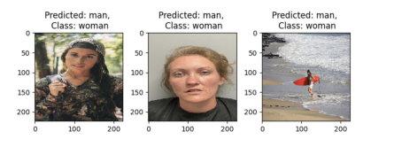
IT21387562 | E.M.A.M.EKANAYAKE | 24_25J_195

Slide 47
Research Problem and Gap.
Current research on bias in image analysis lacks a specific metric designed to measure contextual bias.
Singh, K. K., Mahajan, D., Grauman, K., Lee, Y. J., Feiszli, M., and Ghadiyaram, D.,- 2020 “Don’t judge an object by its context: Learning to overcome contextual bias,”.
Sharat Agarwal *1 , Sumanyu Muku∗2 , Saket Anand1 , and Chetan Arora-2021“Does Data Repair Lead to Fair Models? Curating Contextually Fair Data To Reduce Model Bias,”.
Ruyang Li, Hao LiU,Ge Li , D., - 2022 “Contextual Debiasing for Visual Recognition with Causal Mechanisms,”.
Utsab Khakurel and Danda B. Rawat -2023 “On the Performance of Machine Learning Fairness in Image Classification,”.
IT21387562 | E.M.A.M.EKANAYAKE | 24_25J_195

Slide 48
Research Problem and Gap.
Existing studies often use Relevance Map Accuracy (RMA) and Rank Relevance Accuracy (RRA) to evaluate model performance.
chaaf, N., Mitri, O., Kim, H., Windberger, A., and Huber, M., [Towards Measuring Bias in Image Classification], 433–445 (09 2021)
Relevance Map Accuracy (RMA): Assesses how well the model identifies relevant areas.
Rank Relevance Accuracy (RRA): Measures the accuracy of pixel ranking.
IT21387562 | E.M.A.M.EKANAYAKE | 24_25J_195

Slide 49
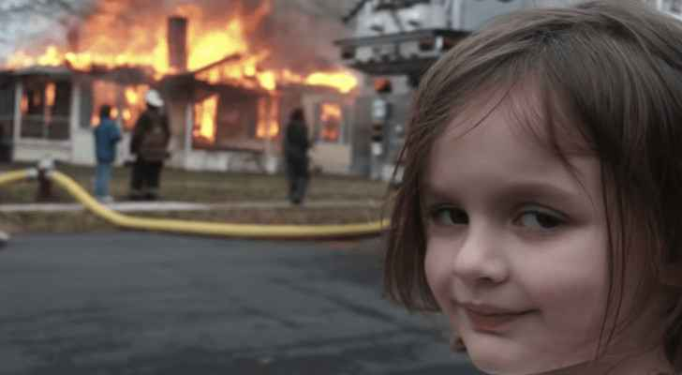
Research Problem and Gap.
This will help us understand how contextual bias can appear in image datasets and be missed by existing evaluation metrics.
IT21387562 | E.M.A.M.EKANAYAKE | 24_25J_195

Slide 50
Objectives.
Specific Objective.
Develop a novel metric specifically designed to measure contextual bias in image datasets, addressing the limitations of existing metrics such as Relevance Map Accuracy (RMA) and Rank Relevance Accuracy (RRA).
Sub Objective.
Understanding of the Contextual Bias.
Identify the limitations of excising metrics.
Understanding and Testing on cross-modality applicability.
IT21380914 | K. M. S. P. Jayawardena | 24_25J_195

Slide 51
Proposed Methodology.
System Diagram
Requirement specification.
Gantt chart.
Technologies to be used.
IT21387562 | E.M.A.M.EKANAYAKE | 24_25J_195

Slide 52
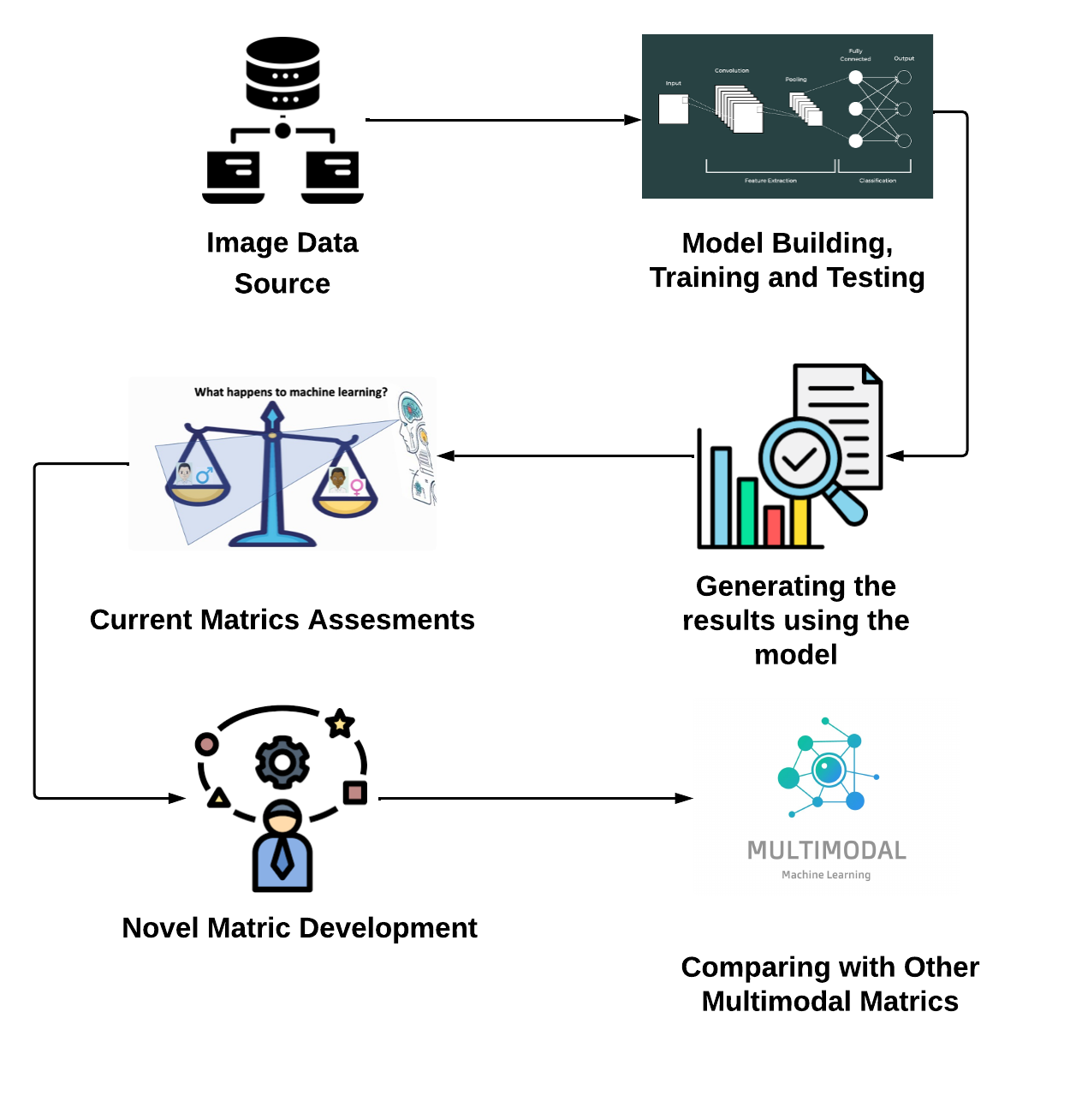
System diagram.
IT21387562 | E.M.A.M.EKANAYAKE | 24_25J_195

Slide 53
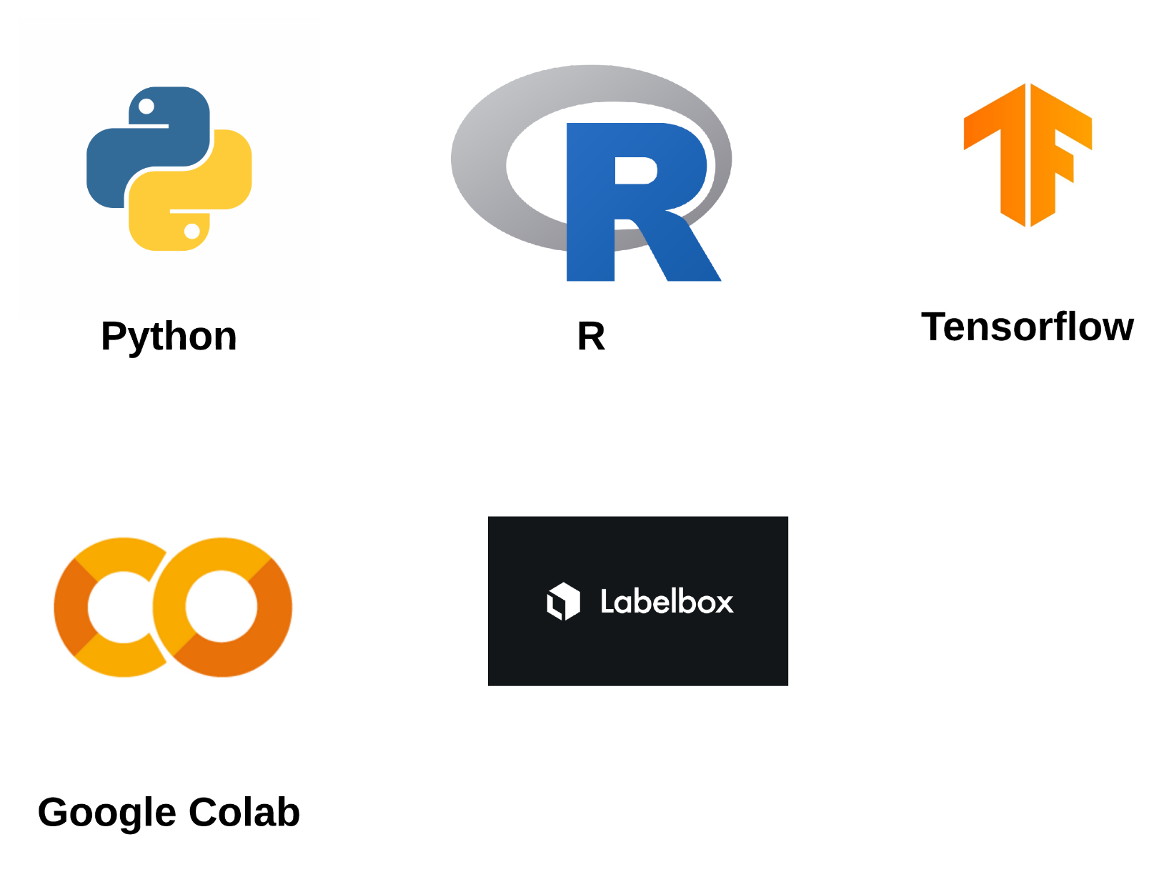
Technologies to be used.
IT21387562 | E.M.A.M.EKANAYAKE | 24_25J_195

Slide 54
Requirements specification.
Functional requirements
The system should be able to:
Detect and measure contextual bias.
Overcome the limitations of existing metrics.
Handle different types of image datasets and provide clear outputs.
Non-functional requirements
Reliable.
Interoperability.
Scalable.
Ethical.
IT21387562 | E.M.A.M.EKANAYAKE | 24_25J_195

Slide 55
References.
Singh, K. K., Mahajan, D., Grauman, K., Lee, Y. J., Feiszli, M., and Ghadiyaram, D.,- 2020 “Don’t judge an object by its context: Learning to overcome contextual bias,”.
Sharat Agarwal *1 , Sumanyu Muku∗2 , Saket Anand1 , and Chetan Arora-2021“Does Data Repair Lead to Fair Models? Curating Contextually Fair Data To Reduce Model Bias,”.
Ruyang Li, Hao LiU,Ge Li , D., - 2022 “Contextual Debiasing for Visual Recognition with Causal Mechanisms,”.
Utsab Khakurel and Danda B. Rawat -2023 “On the Performance of Machine Learning Fairness in Image Classification,”.
chaaf, N., Mitri, O., Kim, H., Windberger, A., and Huber, M., [Towards Measuring Bias in Image Classification], 433–445 (09 2021)
IT21387562 | E.M.A.M.EKANAYAKE | 24_25J_195

Slide 56

THANK YOU !!
IT21387562 | E.M.A.M.EKANAYAKE | 24_25J_195

